Slide 1

Internal Events and
Scheduled Tasks

Slide 2

Internal Events
What are they?
Internal event plug-ins “listen” for a specific event that is triggered and perform an action when it does (listener pattern).
EVENT
LISTENER
ACTION
Events extend/implement event interface
An Event encapsulates all the information that is needs by the listener to process

Slide 3
Internal Events
How to?
Create the event
Create the listener
Trigger the event

Slide 4
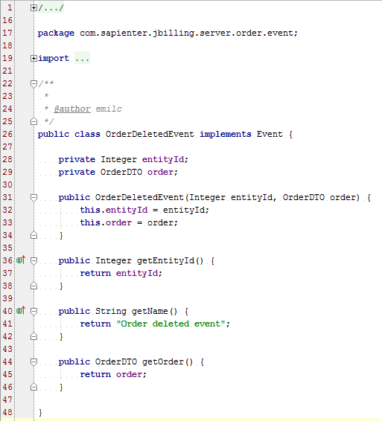
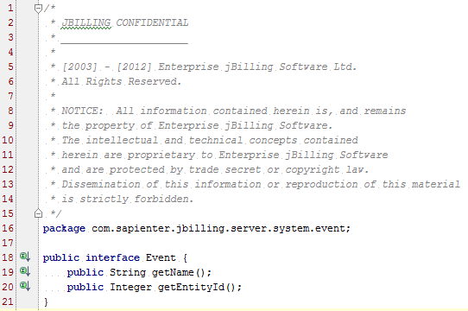
Internal Events
Create the Event

Slide 5
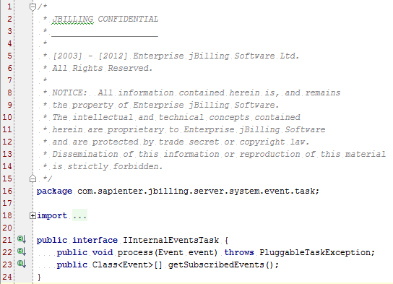
Internal Events
Create the Listener

Slide 6
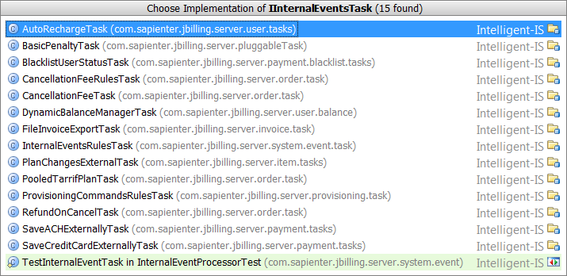
Internal Events
Create the Listener - Implementations

Slide 7
Internal Events
Create the Listener - Architecture
Event A
Event B
Listener 1
Listener 2

Slide 8
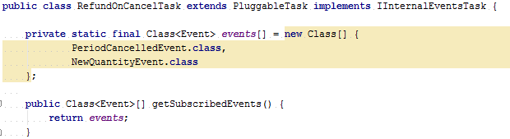
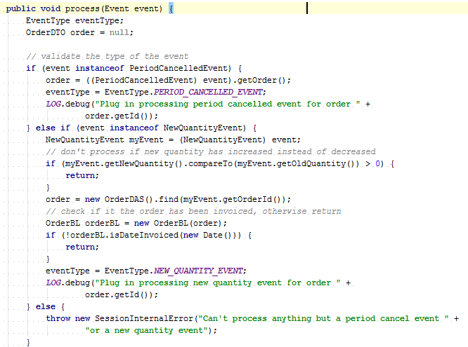
Internal Events
Create the Listener - Implementation

Slide 9
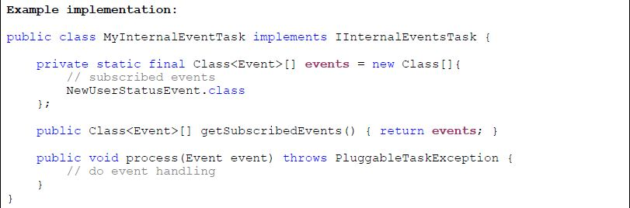
Internal Events
Create the Listener - Template

Slide 10
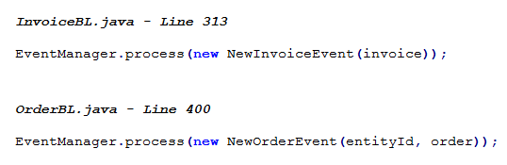
Internal Events
Trigger the Event

Slide 11
Internal Events
Questions?

Slide 12
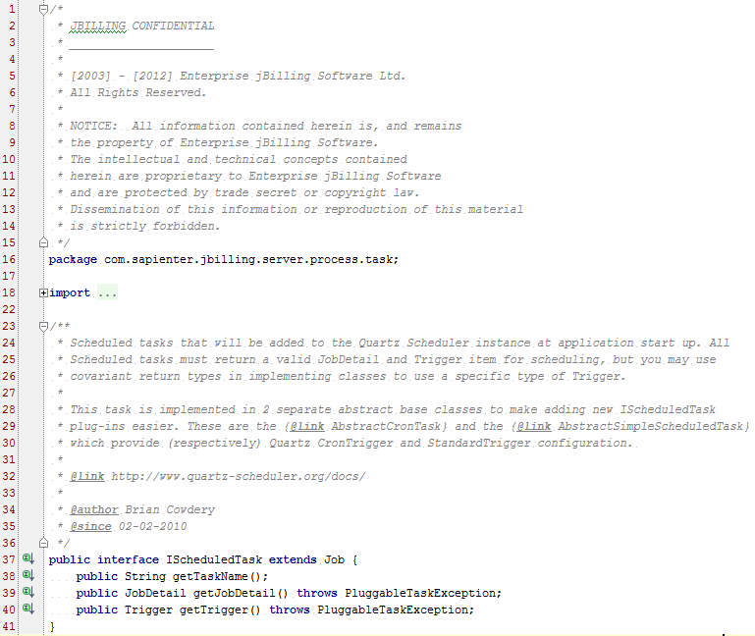
Scheduled Tasks
Pluggable tasks that can be scheduled
Schedulable using simple trigger or a cron expression

Slide 13
Scheduled Tasks
Types
Scheduled Tasks
AbstractCronTask
AbstractSimpleScheduledTasks
AgeingProcessTask
SCPUploadTask
BillingProcessTask
MediationProcessTask

Slide 14
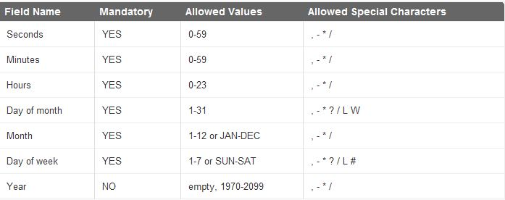
Scheduled Tasks
Types - Cron Trigger
Only one important property: cron_expression
A cron expression is a string composed of min 6 or max 7 characters separated by a white space.
Default cron expression: 0 0 12 * * ? = Fire at 12pm (noon) every day
Fields: seconds, minutes, hours, day of month, month, day of week, year (opt)

Slide 15
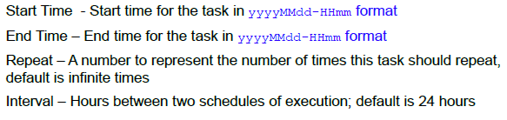
Scheduled Tasks
Types - Simple Trigger
Use a simple trigger based on start time, end time, repeat and interval
Currently only implemented as an instance of AbstractBackwardSimpleScheduledTask

Slide 16
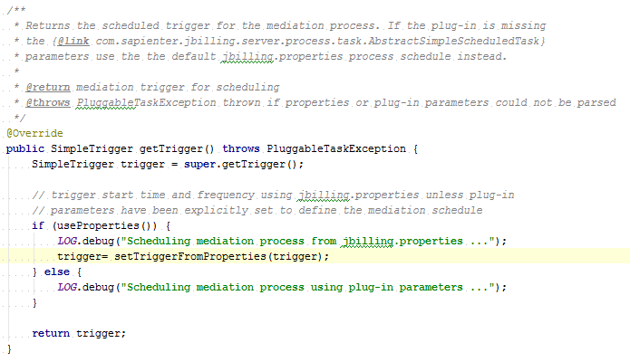
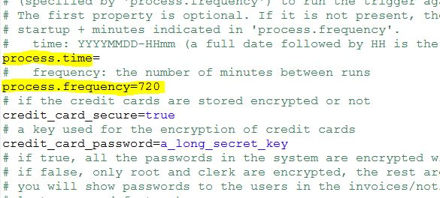
Scheduled Tasks
Types - Simple Trigger

Slide 17
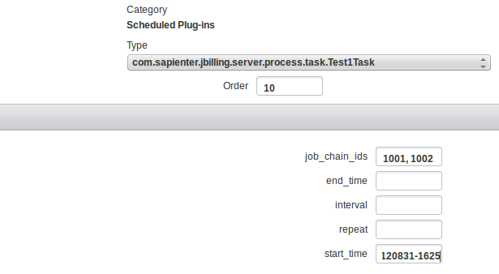
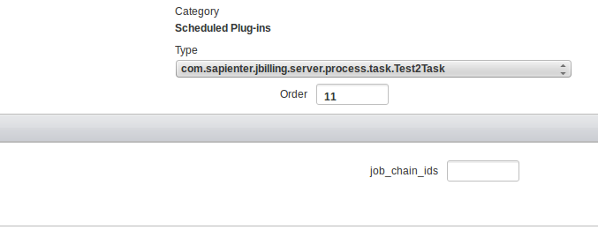
Scheduled Tasks
Types – Chainable scheduler

Slide 18
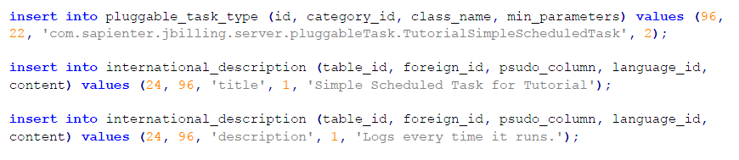
Scheduled Tasks
DB Queries

Slide 19

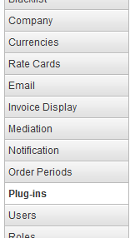
Scheduled Tasks
Configuration

Slide 20
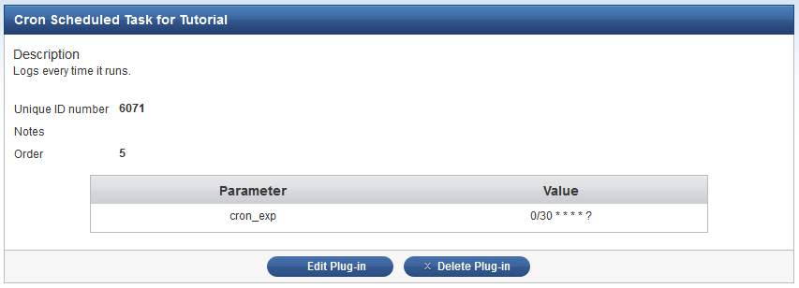
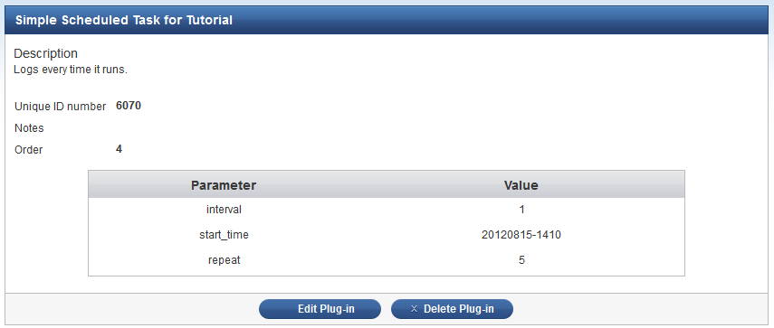
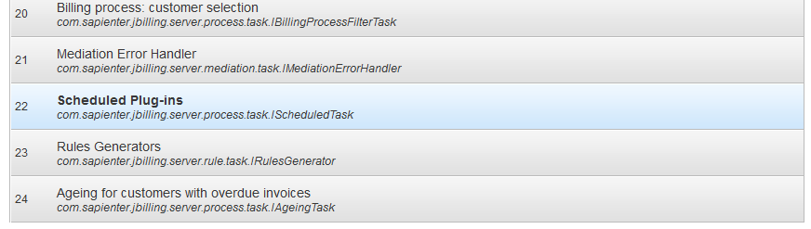
Scheduled Tasks
Configuration

Slide 21
Scheduled Tasks
Documentation
Quartz Documentation
jBilling extension guide

Slide 22
Scheduled Tasks
Questions?

Slide 23
Exercises
Internal Events
Create an event that gets triggered when a category GETS CREATED. CREATE A LISTENER THAT will add an internal ASSET status called ‘locked’ to the category.

Slide 24
Exercises
Scheduled Tasks
Create a scheduled task triggered by a cron expression to run every 1 hour and log the number of free mb available on the file system.
Send a diff patch with the changes

